Slide 1
Malikmamed Kill the betrayers!
Game Pitch Presentation (Homework No.4)
https://youtu.be/LYmd0rEoyDE
Project team: HahaSoEasy
Instructor: Dr. Araz Yusubov

Slide 2
Team contribution
Presented in partial fulfillment of the requirements of the Game Development Fundamentals course project
Team member | Contribution to this homework (NOT the project) | Estimated %
Fidan Sadirli | Introduction, Main Character, Opponents | 25%
Selin Hebipoghlu | quest, main charcater | 25%
Chingiz Huseynzade | Menu,control, sound | 25%
Narmin Salahli | Environment | 25%

Slide 3
Introduction
Malikmamed is a 2D side-scroller adventure game that is inspired by Azerbaijani fairytale Malikmamed and carries the main storyline and motives of it. The objective of the game is to navigate the player’s character through different environments - apple tree yard, underworld, dark world and to kill antagonists of the game - Giants and betraying brothers of the main character.

Slide 4




Game Description: The Quest

Slide 5
Game Description: Main Character
The sole player of the game is Malikmamed which in the boss fight stage of the game is accompanied by Phoenix. Malikmamed could jump, slide down, move to right and left and attack with his sword. Malikmamed has quiver on his back to collect apples. He collects the apples which are on his way or may jump to get apples which are on platforms above the floor. He collects meat and water for Phoenix, attacks the Giant, and breaks the life capsule of the Giant.

Slide 6
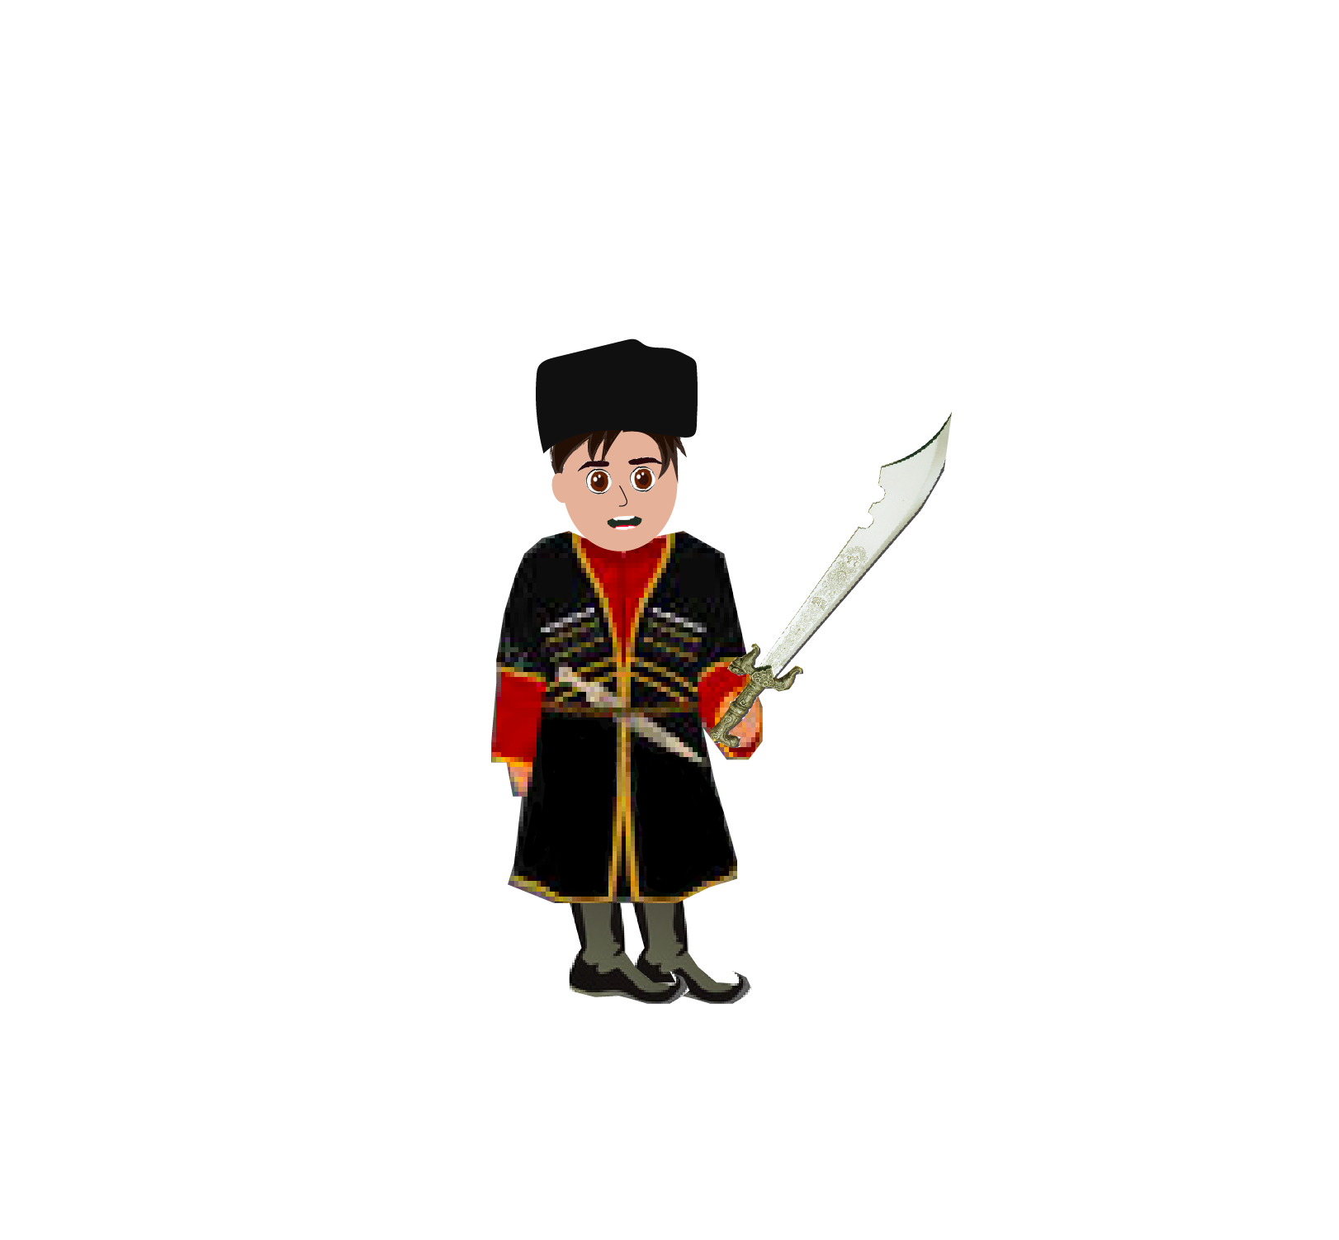
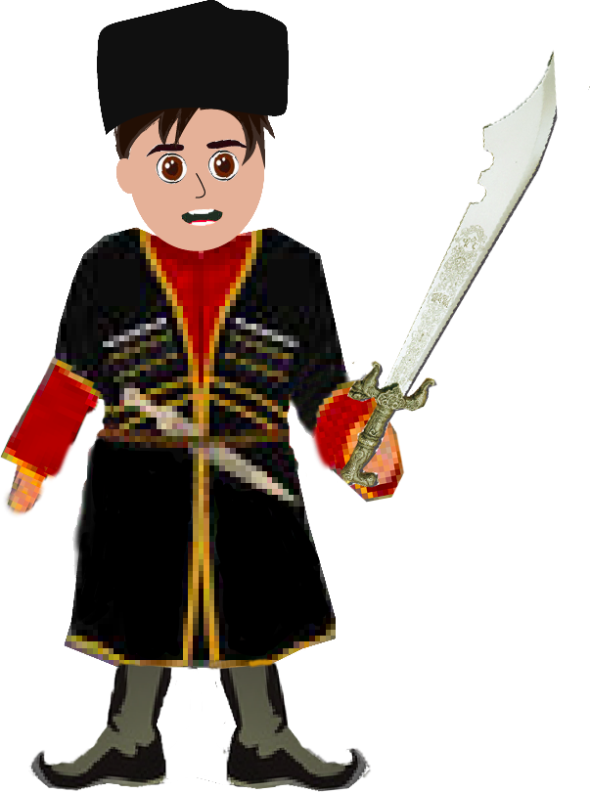

Slide 7
Game Description: Opponents
There are several types of opponents of Malikmamed: Giant, black sheep, brothers, dragon. All characters except black sheep will revenge Malikmamed by specific power. Dragon have the ability to breath fire, the Giant has the ability to punch and brothers are fighting with sword just as Malikmamed does. While touching white sheep result with gaining 3 points, black sheep will result with losing 3 points. To sum up, all antagonists are barriers to continue the game and are conducive for losing.

Slide 8
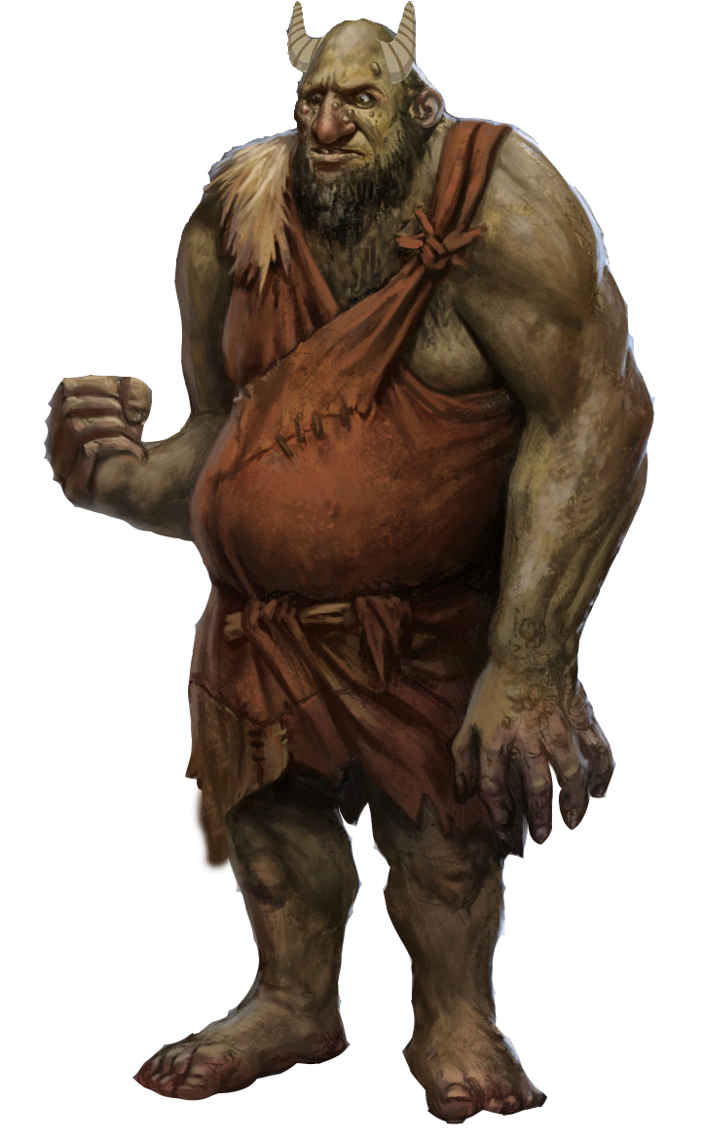


Slide 9
Game Description: Environment
Game will be played in different environments such as apple tree yard, underworld, dark world and to kill antagonists of the game.

Slide 10

Apple Tree Yard

Slide 11

Apple Tree Yard

Slide 12
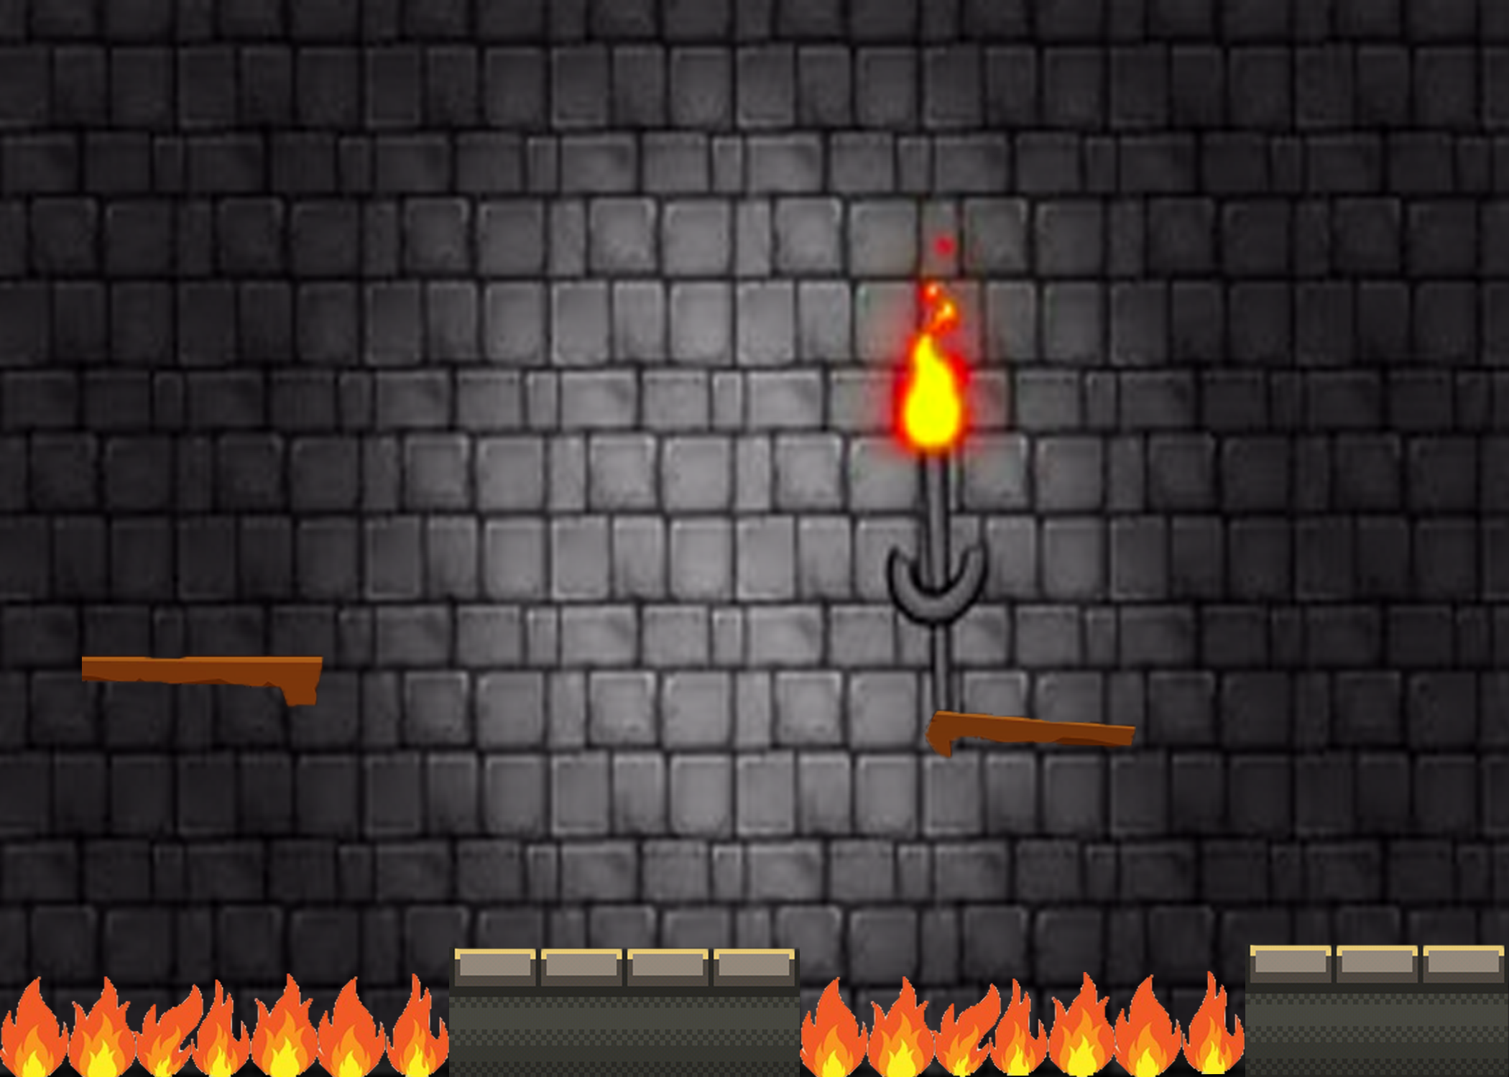
Underworld

Slide 13
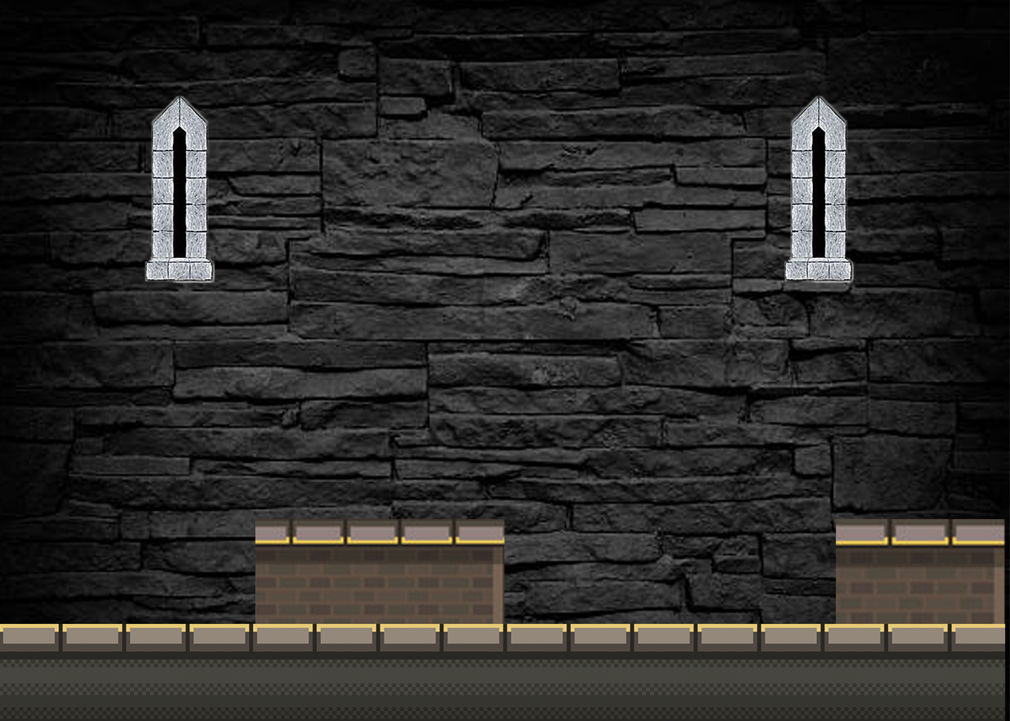
Underworld

Slide 14
Game Description: Menus
Start
Exit

Slide 15
Game Description: Controls
Left
Right
Jump
Attack

Slide 16
Game Description: Sounds:
Audio source
Audio Listener

